Slide 1


21 DAYS OF
MACHINE LEARNING
15/21
---Code Warriors---

Slide 2

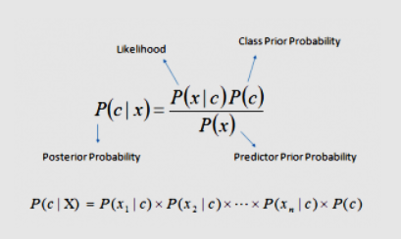
What is Naive Bayes algorithm?
It is a classification technique based on Bayes’ Theorem with an assumption of independence among predictors. In simple terms, a Naive Bayes classifier assumes that the presence of a particular feature in a class is unrelated to the presence of any other feature.
Bayes theorem provides a way of calculating posterior probability P(c|x) from P(c), P(x) and P(x|c). Look at the equation below:
---Code Warriors---

Slide 3
Naive Bayes
1
from sklearn.naive_bayes import GaussianNB
2
model = GaussianNB()
3
model.fit(train_x,train_y)
---Code Warriors---

Slide 4
Naive Bayes
Advantages
Dis-Advantages
It is easy and fast to predict class of test data set. It also perform well in multi class prediction
When assumption of independence holds, a Naive Bayes classifier performs better compare to other models like logistic regression and you need less training data.
If categorical variable has a category (in test data set), which was not observed in training data set, then model will assign a 0 (zero) probability and will be unable to make a prediction. This is often known as “Zero Frequency”. To solve this, we can use the smoothing technique. One of the simplest smoothing techniques is called Laplace estimation..
Another limitation of Naive Bayes is the assumption of independent predictors. In real life, it is almost impossible that we get a set of predictors which are completely independent..
---Code Warriors---

Slide 5




Applications of Naïve Bayes
Text classification/ Spam Filtering/ Sentiment Analysis
Recommendation System
Multi class Prediction
Real time
Prediction
---Code Warriors---

